Slide 1
Customer Bookings Sentiment Analysis
We will now evaluate our model on the test set with respect to classification accuracy. But we will also take a look the model's confusion matrix. In the case of predicting customer's booking satisfaction, it is important to see if our machine learning model is equally capable of predicting satisfied and unsatisfied, in line with the frequency of these labels in our original dataset. If our model is not performing well in this aspect, then it might end up predicting customer satisfied in place where the customer is not satisfied. The confusion matrix helps us to view our model's performance from these aspects.

Slide 2
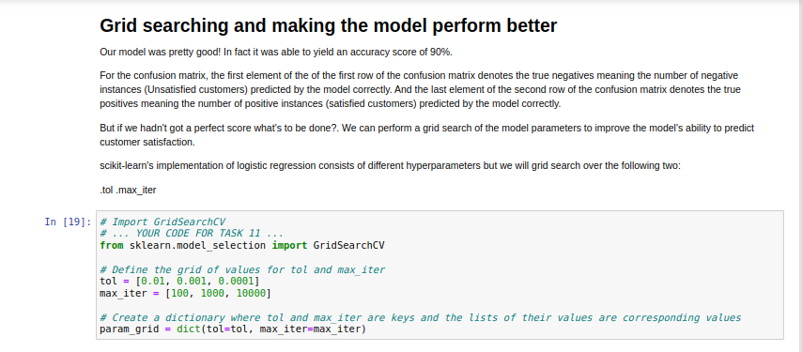

Slide 3
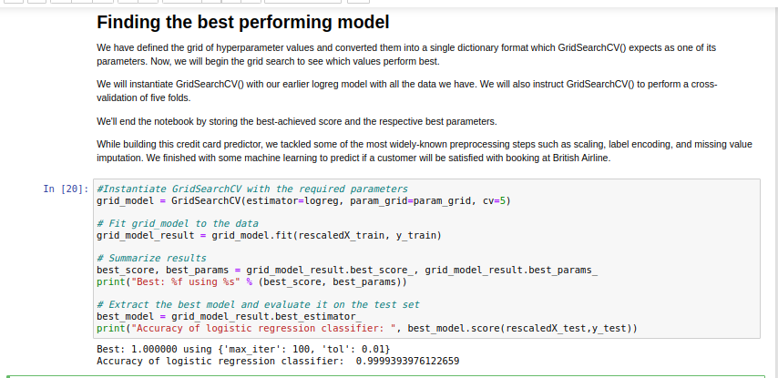
This work is licensed under a Creative Commons Attribution-ShareAlike 3.0 Unported License. It makes use of the works of Mateus Machado Luna.

